Slide 1

Module 2
Exploratory Data Analysis (EDA)
Notes:
Guidelines
Use section headers to chunk content in your presentation.
Use the same style of section header throughout your presentation.
Keep your title to no more than 2 lines.

Slide 2

EDA – Encoding Categorical Variables
Notes:
Guidelines
Use a title slide at the beginning of your presentation. There are 9 variations of title slides to choose from.
If you will have a series of slideshows, we recommend using the same style of title slide for each presentation.
Keep your title to no more than 2 lines.
Do not change the font style or font size of the title or subtitle.

Slide 3
Encoding Categorical Variables
We have to encode categorical variables
Before building models all variables must be numerically encoded
We need to fix first incorrect variable types

Slide 4
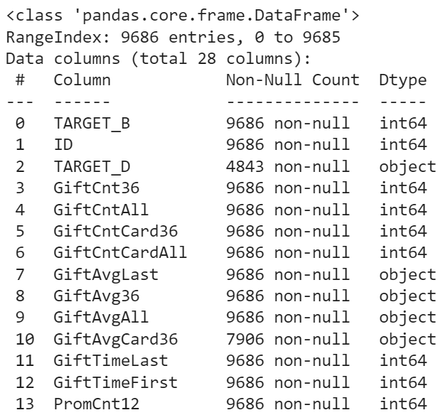
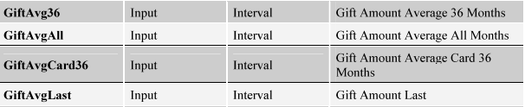
Encoding Categorical Variables
Which variables are incorrect types (if any)?
Object to Float

Slide 5
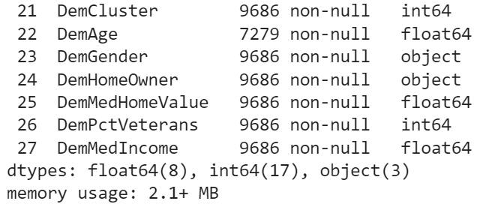
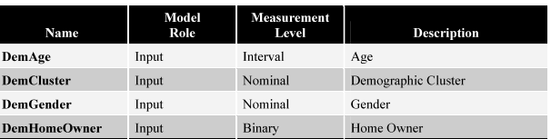
Encoding Categorical Variables
Which variables are incorrect types (if any)?
Int64 to object

Slide 6
Python
Notes:
Guidelines
Use a title slide at the beginning of your presentation. There are 9 variations of title slides to choose from.
If you will have a series of slideshows, we recommend using the same style of title slide for each presentation.
Keep your title to no more than 2 lines.
Do not change the font style or font size of the title or subtitle.

Slide 7
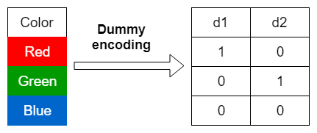
Dummy-Encoding
Used when the number of levels is not excessive
The pd.get_dummies() function is useful
drop_first = True

Slide 8
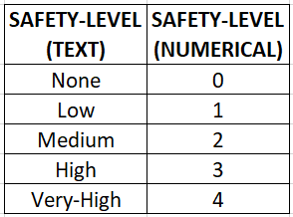
Label-Encoding
Used for ordinal-type variables
Used for categorical variables with many levels

Slide 9
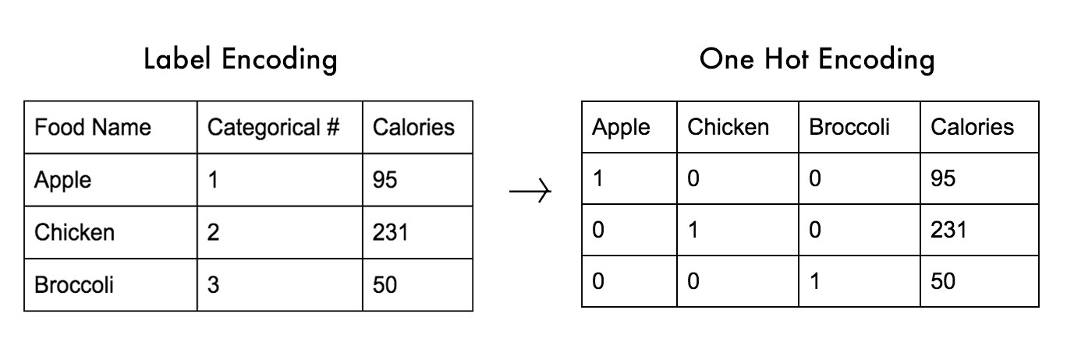
One-Hot Encoding
Similar to dummy-encoding
Used to indicate presence/absence of levels
Popular in Neural Networks

Slide 10
Python
Notes:
Guidelines
Use a title slide at the beginning of your presentation. There are 9 variations of title slides to choose from.
If you will have a series of slideshows, we recommend using the same style of title slide for each presentation.
Keep your title to no more than 2 lines.
Do not change the font style or font size of the title or subtitle.

